Slide 1
Complete Search
Prepared by
Ahmed Tarek

Slide 2
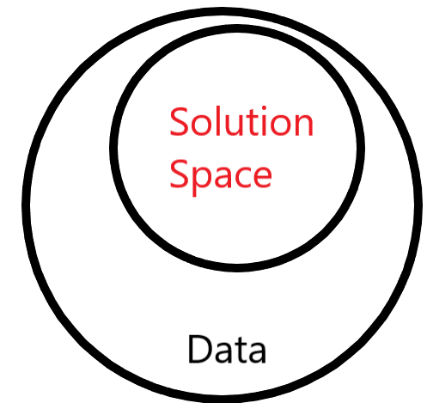
Solution Space
Solution space is the set of all possible solutions for the combinatorial optimization problem

Slide 3
Basic Complete Search
1
In many problems it suffices to check all possible cases in the solution space

Slide 4
Complete Search
Complete search is a general method that can be used to solve almost any algorithm problem. The idea is to generate all possible solutions to the problem using brute force, and then select the best solution or count the number of solutions, depending on the problem.
Complete search is a good technique if there is enough time to go through all the solutions, because the search is usually easy to implement, and it always gives the correct answer. If complete search is too slow, other techniques, such as greedy algorithms or dynamic programming, may be needed.

Slide 5
Problems
https://codeforces.com/problemset/problem/626/A
https://codeforces.com/contest/268/problem/A
https://codeforces.com/problemset/problem/1359/B
https://codeforces.com/contest/546/problem/B
https://atcoder.jp/contests/abc237/tasks/abc237_b
https://codeforces.com/contest/263/problem/A
5

Slide 6

Activity!

Slide 7
Introduction To Prefix Sum
2
Computing range sum queries in constant time over a fixed 1D array.

Slide 8
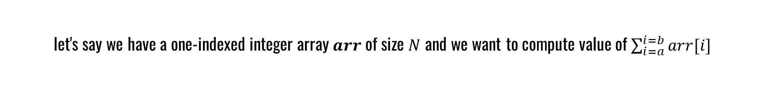
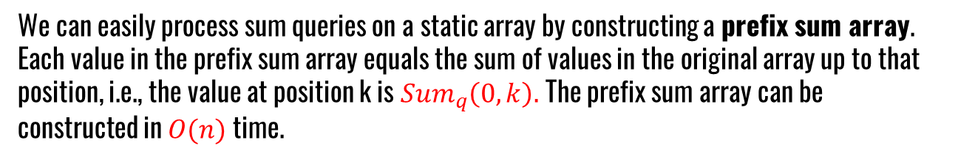
Prefix Sum
Sum queries
We can easily process sum queries on a static array by constructing a prefix sum array. Each value in the prefix sum array equals the sum of values in the original array up to that position, i.e., the value at position k is ${Sum}_{q}\left(0,k\right).$The prefix sum array can be constructed in $O(n)$time.
let's say we have a one-indexed integer array$arr$of size $N$ and we want to compute value of $\sum_{i=a}^{i=b}{arr[i]}$
$$arr\left[a\right]+arr\left[a+1 \right]+arr\left[a+2 \right]+…+…+arr[b]$$

Slide 9
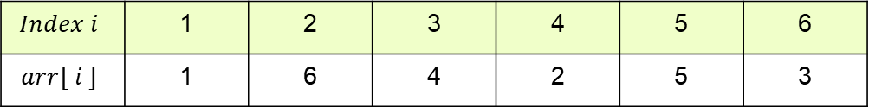
Prefix Sum
$$Index i$$ | 1 | 2 | 3 | 4 | 5 | 6
$$arr[ i ]$$ | 1 | 6 | 4 | 2 | 5 | 3
0 | 1 | 7 | 11 | 13 | 18 | 21

Slide 10
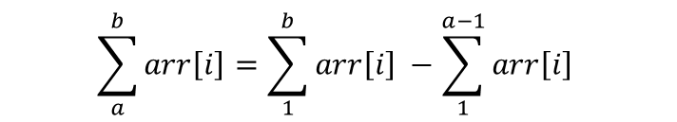
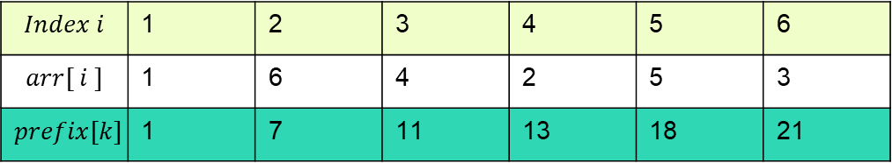
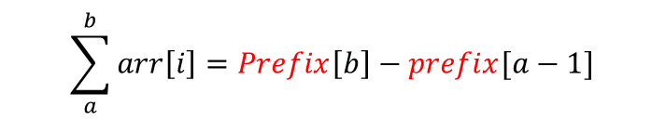
Prefix Sum
$$Index i$$ | 1 | 2 | 3 | 4 | 5 | 6
$$arr[ i ]$$ | 1 | 6 | 4 | 2 | 5 | 3
$$prefix[k]$$ | 1 | 7 | 11 | 13 | 18 | 21
$$\sum_{a}^{b}{arr\left[i\right]=\sum_{1}^{b}{arr\left[i\right] −\sum_{1}^{a−1}{arr\left[i\right] }}}$$
$$\sum_{a}^{b}{arr\left[i\right]=Prefix\left[b\right]−prefix[a−1]}$$

Slide 11
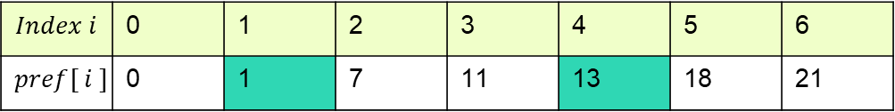
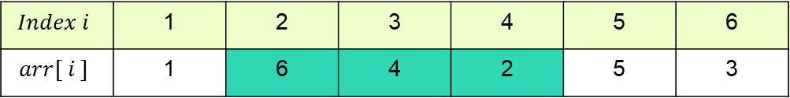
Prefix Sum
$${Sum}_{q}\left(2,4\right)=6+4+2$$
$$Index i$$ | 1 | 2 | 3 | 4 | 5 | 6
$$arr[ i ]$$ | 1 | 6 | 4 | 2 | 5 | 3
$${Sum}_{q}\left(2,4\right)=pref\left[4\right]−pref[2−1]$$
$$Index i$$ | 0 | 1 | 2 | 3 | 4 | 5 | 6
$$pref[ i ]$$ | 0 | 1 | 7 | 11 | 13 | 18 | 21

Slide 12
Problems
https://leetcode.com/problems/running-sum-of-1d-array/
https://leetcode.com/problems/minimum-value-to-get-positive-step-by-step-sum/
https://codeforces.com/contest/433/problem/B
https://codeforces.com/contest/1539/problem/B
12

Slide 13
THANKS!
Any questions?

